Slide 1


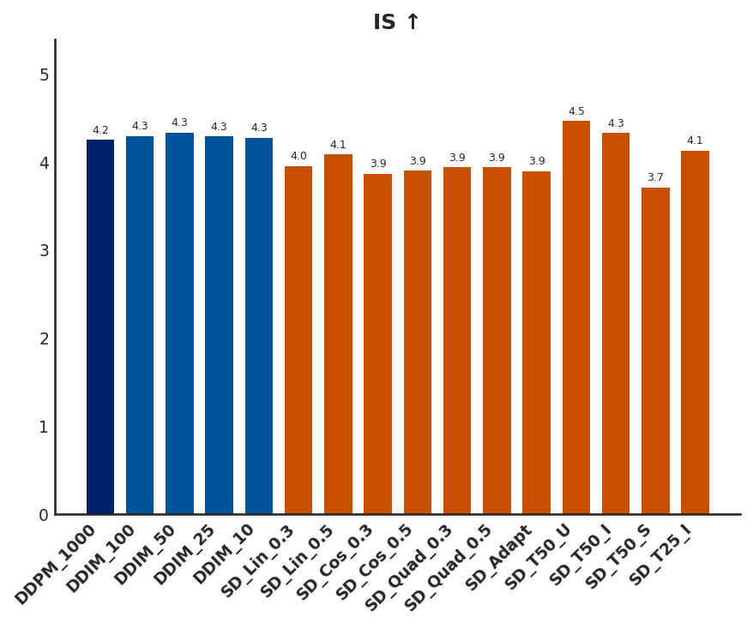
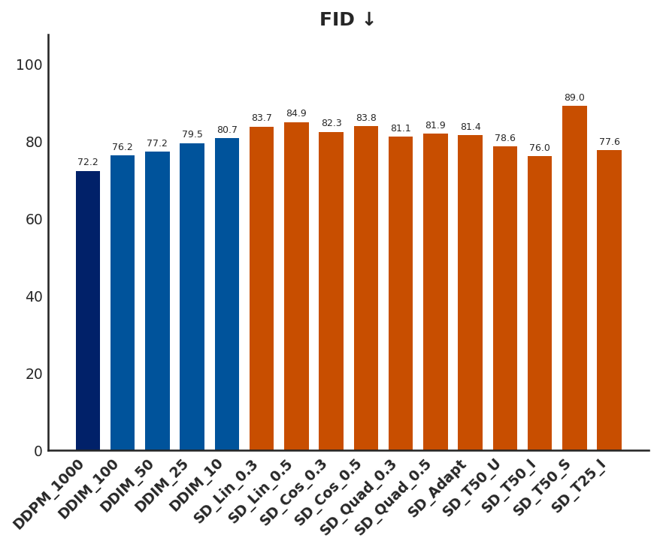
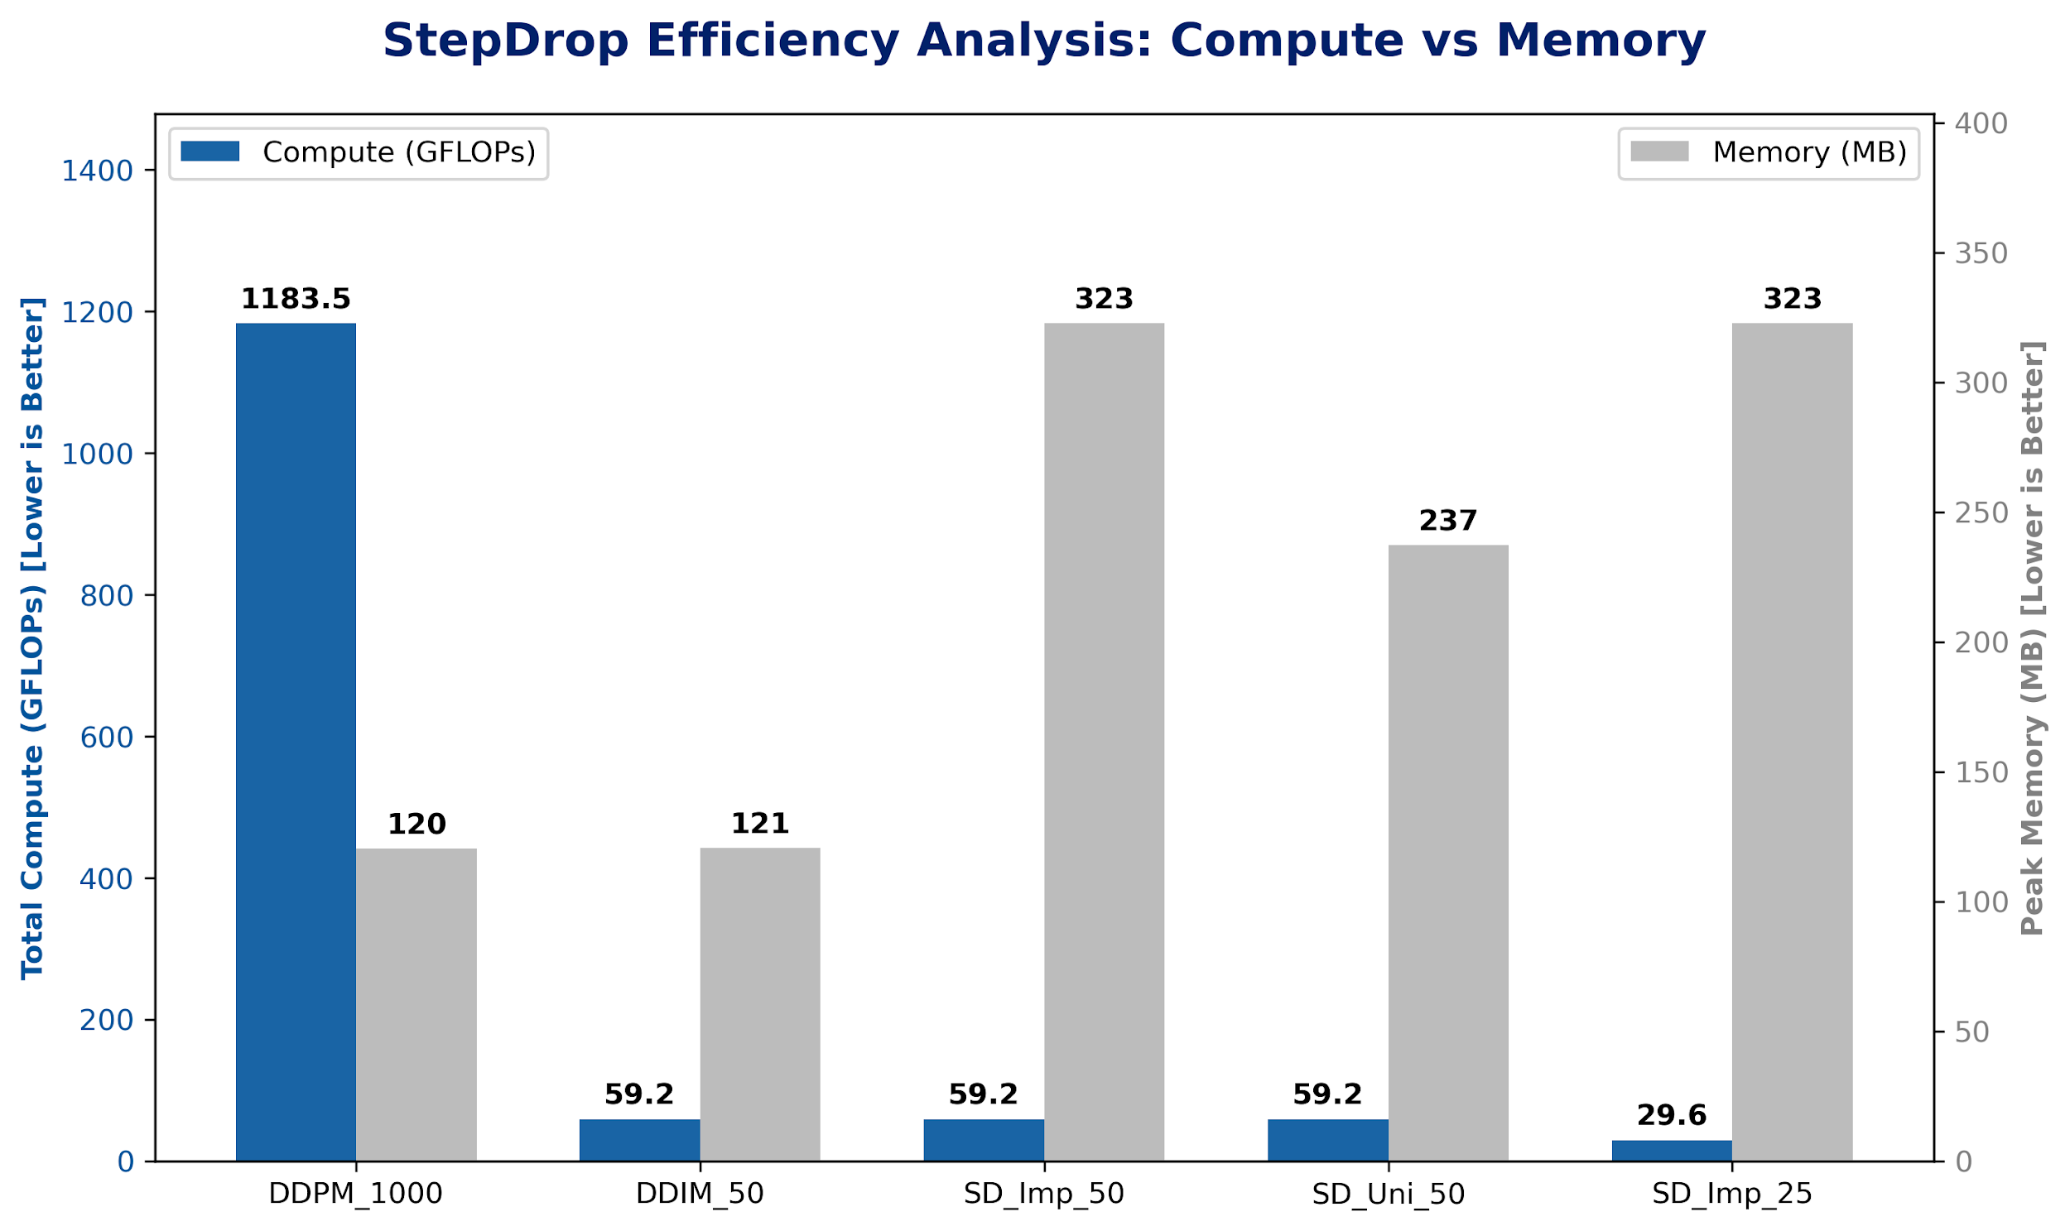
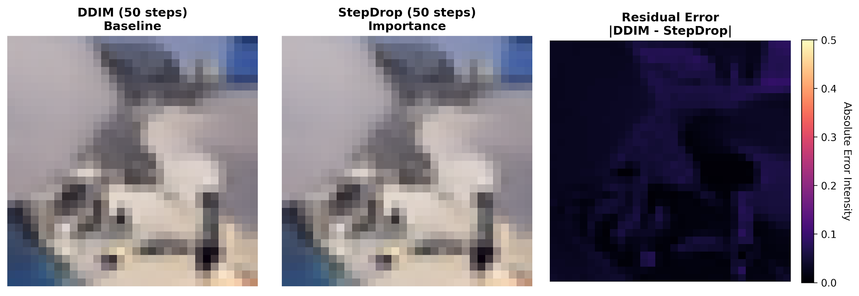
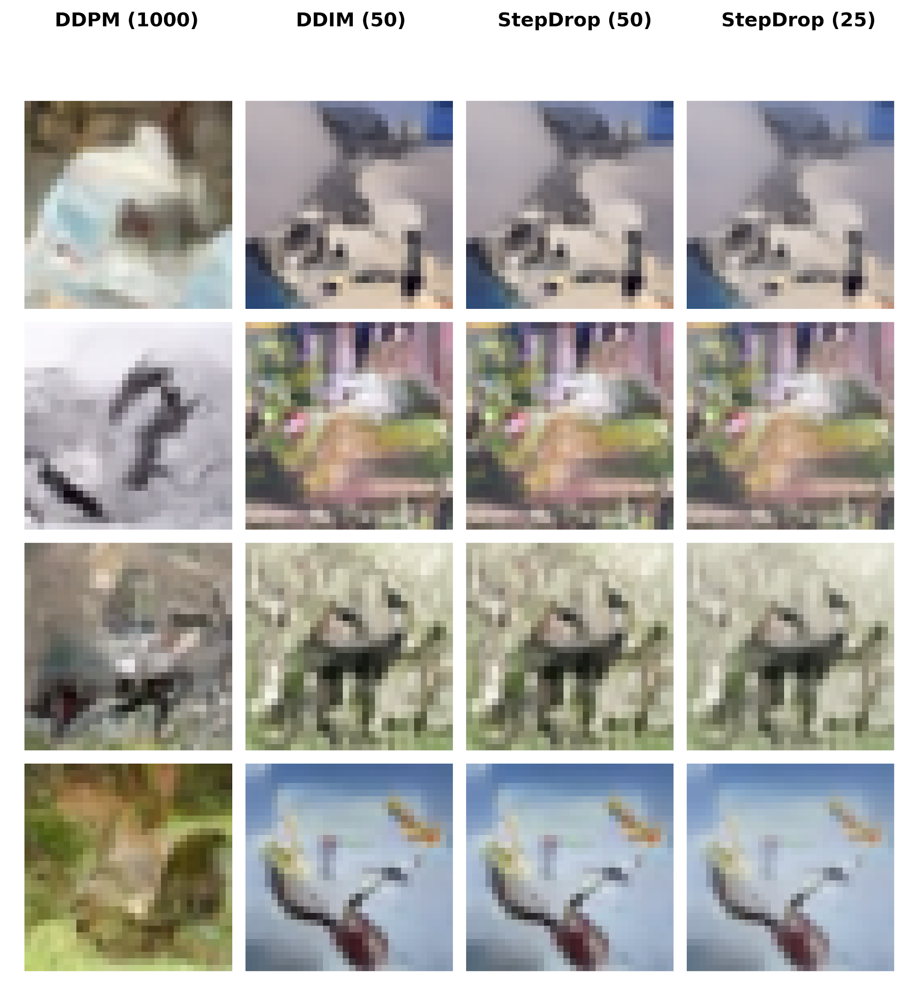
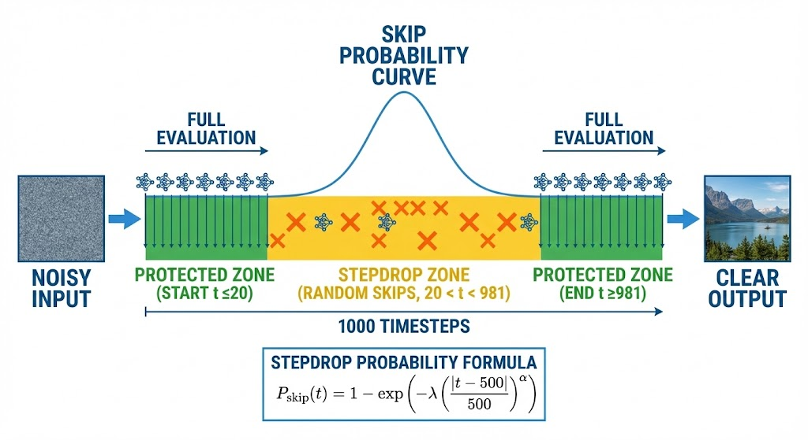
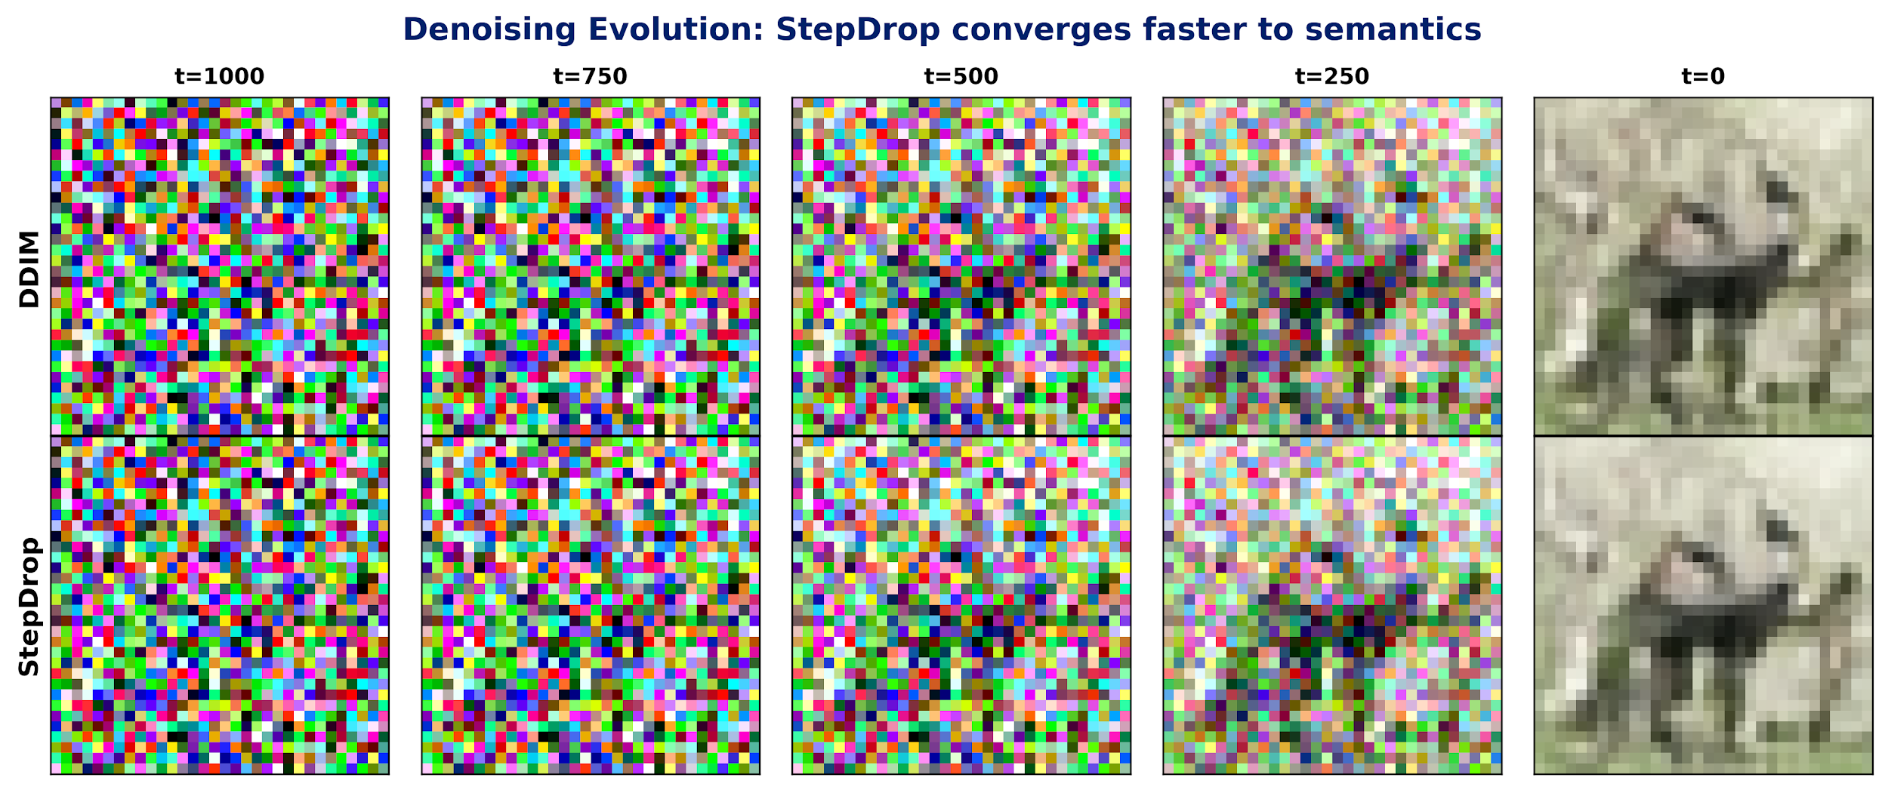
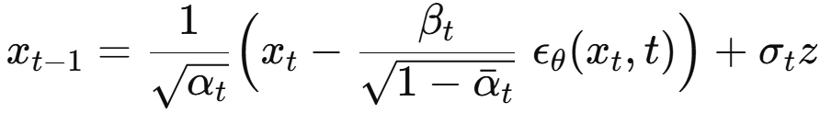

StepDrop: Accelerating Tiny Diffusion Models with Stochastic Step Skipping
Wanghley Soares Martins¹, Nicolas Vasilescu¹, Logan Chu¹
¹Department of Electrical and Computer Engineering, Pratt School of Engineering
Introduction
Results
Conclusions
High inference latency is the principal barrier to the widespread deployment of powerful tiny diffusion models. While these models exhibit impressive performance in image synthesis, their sequential, iterative denoising process incurs substantial computational cost, which is prohibitive for resource-constrained edge devices and real-time applications. This work is motivated by the critical need for efficient sampling techniques that can drastically accelerate inference without a commensurate degradation in the fidelity of the generated output. Developing a solution that maintains high-quality generation of DDPM/DDIM while ensuring practicality and speed is essential for advancing the applicability of these models.
Objectives
Train a baseline tiny diffusion model (DDPM/DDIM).
Implement stochastic and adaptive step-skip schedulers.
Enable probabilistic omission of denoising steps.
Compare stochastic vs. deterministic step reduction.
Evaluate using standard image-quality metrics.
Figure 2: Image Quality Metrics Across Sampling Methodsflow.
Source: by the authors, 2025
Quality under compression: StepDrop consistently outperforms uniform skipping at the same NFE.
50 NFE: Achieves FID 76.05, improving over DDIM’s 77.20 with identical compute.
25 NFE: Matches DDIM-50 quality while doubling throughput.
Compute efficiency: Skipping UNet calls reduces cost from 59 → 29.5 GFLOPs, yielding proportional energy savings for edge deployment.
Figure 5: StepDrop efficiency–performance tradeoff.
Source: by the authors, 2025
Method
Diffusion cost stems from uniform sampling, despite uneven step importance (early = structure, late = texture, middle = low-value).
StepDrop targets high-value steps, cutting compute by 50% while improving FID (+2.5) and keeping IS stable.
Offers best fidelity per FLOP with flexible compute–memory tradeoffs; residuals show strong agreement with DDIM.
Training:
Dataset: CIFAR-10 | Loss: MSE on noise prediction | Optimizer: AdamW
Step-Skipping Schedulers
Uniform: skips occur evenly across all timesteps.
Quadratic: skips are strongly concentrated in the middle.
Cosine: skips are smooth and most frequent toward the middle.
Adaptive: dynamically selects steps based on predicted noise magnitude
Stochastic Step Dropping (based on Wang et al., 2024)
Figure 1: Boundary preservation and stochastic mid-step skipping flow.
Source: by the authors, 2025
Evaluation Metrics
FID (Fréchet Inception Distance): Measures the distance between feature distributions of generated and real images.
IS (Inception Score): Measures both quality (recognizability) and diversity (content variety).
Practical: zero-training, plug-and-play acceleration for any diffusion model; boosts edge viability and reduces serving energy.
Future: extend to latent diffusion, build adaptive kernels, and reduce the ~3× memory overhead from precomputed timestep schedules
Figure 3: Local fidelity comparison between DDIM and StepDrop.
Source: by the authors, 2025
Diffusion steps vary in importance, with clear temporal structure in their contribution to image quality.
Importance-based StepDrop improves FID by 2.5, showing early and late steps matter most, while mid-trajectory steps add little.
The model is robust to skipping during the mid “drift” phase, where updates have minimal perceptual impact.
Focusing computation on high-value steps yields better image quality per compute and outperforms rigid step schedules.
Figure 6:Strategies generation comparison.
Source: by the authors, 2025
References
DDPM (Ho et al., 2020): Stochastic, Markovian sampler
DDIM (Song et al., 2020): Deterministic, Non-Markovian sampler
Ho, J., Jain, A., & Abbeel, P. (2020). Denoising diffusion probabilistic models. arXiv. https://doi.org/10.48550/arXiv.2006.11239
lucidrains. (2023). denoising-diffusion-pytorch (Version 2.2.5) [Computer software]. GitHub. https://github.com/lucidrains/denoising-diffusion-pytorch
Martins, W.S., Vasilescu, N., & Chu, L. (2025). stepdrop-tiny-diffusion [Computer software]. GitHub. https://github.com/wanghley/stepdrop-tiny-diffusion
Song, J., Meng, C., & Ermon, S. (2020). Denoising diffusion implicit models. arXiv. https://doi.org/10.48550/arxiv.2010.02502
Wang, Y., & Li, S. (2024). S2-DMs: Skip-step diffusion models. arXiv. https://doi.org/10.48550/arxiv.2401.01520
Xue, S., Liu, Z., Chen, F., Zhang, S., Hu, T., & Xie, E. (2024). Accelerating diffusion sampling with optimized time steps. 2024 IEEE/CVF Conference on Computer Vision and Pattern Recognition (CVPR) (pp. 8254–8263). IEEE. https://doi.org/10.1109/CVPR52733.2024.00792
Figure 4: Denoising evolution: StepDrop reaches semantic structure faster.
Source: by the authors, 2025

